Slide 1
Prenatal Tdap Vaccination: Quality Improvement to Reduce Infant Mortality
Sona Aggarwal, MD MPH
Misa Perron-Burdick, MD, MAS
Cora Hoover, MD MPH
San Francisco Department of Public Health
www.sfcdcp.org/tdaptoolkit
March 22, 2016

Slide 2
Today’s Agenda
Background on pertussis and vaccination
Quality improvement tips and tricks
QI Toolkit and website
Evaluation and feedback

Slide 3
Objectives
Understand the reasons for Tdap vaccination in pregnancy
Know vaccination guidelines
Understand how to carry out a small quality improvement (QI) project to improve vaccination rates in your practice
Understand where to go for resources around QI and Tdap vaccination

Slide 4
Who’s on the call today?
Quality Improvement staff
Non-clinical Manager
Clinical staff – Ob/Gyn
Clinical staff – Primary Care
Public Health Department Staff
Other

Slide 5
At what age do infants become fully immune to pertussis?
6 months
10 months
18 months
24 months
Notes:
Answer C

Slide 6
The problem of pertussis
Pertussis (whooping cough) is a highly contagious bacterial infection that is preventable with vaccination
Full protection against pertussis is only achieved after the 4th dose of vaccine at 15-18 months
Newborns and infants are most vulnerable to suffering serious complications or death due to pertussis
The person most likely to transmit pertussis to an infant is mom
Notes:
We’ll start with an overview of pertussis. Pertussis is a highly contagious bacterial infection that can be prevented with vaccination. Infants get their first vaccines at 2 months of life, however full protection is only achieved after the 4th dose of vaccine at 15-18 months. We know that newborns and infants are the most vulnerable to severe complications from pertussis, including death, and that mothers are most likely to transmit the disease to an infant.

Slide 7
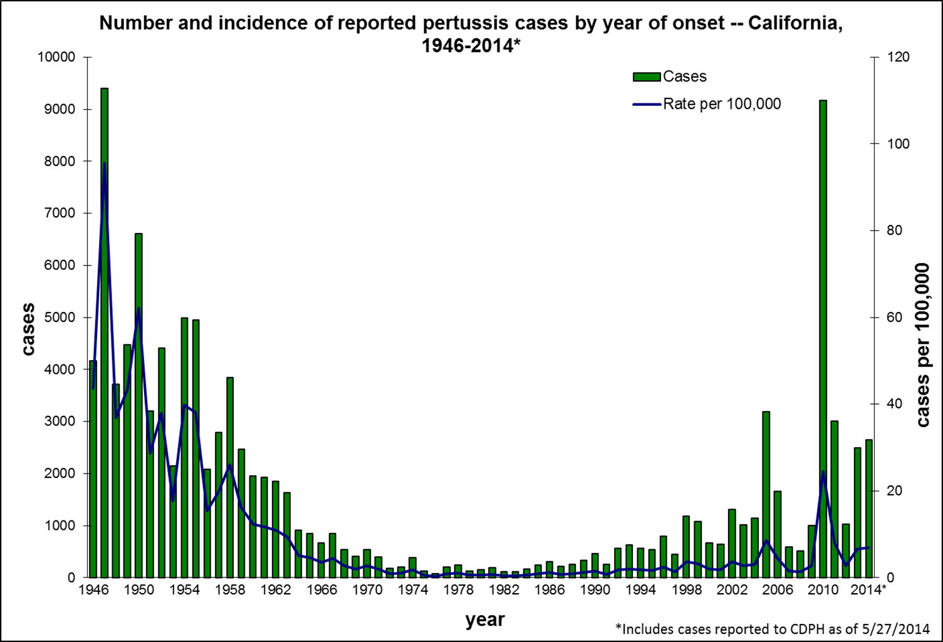
Notes:
This graph represents the number of cases of pertussis in California over the past 60 years. The pertussis vaccine was introduced in the late 1940s with a subsequent decline reaching a nadir throughout the 1970s. We started noticing an increase in the incidence of pertussis starting in the 1990s and leading to an epidemic year in 2010 which is the spike you see on the right-hand side of the screen. Currently we’re seeing a level of pertussis similar to the 1950s. Other states have experienced a similar trend. There are many reasons the incidence of pertussis may be increasing. It may be due to an increase in non-vaccinators, an increase diagnosis due to newer PCR-testing or increased community and provider awareness leading to more testing. Finally, in the 1990s we changed from a live whole-cell to an acellular vaccine which may confer less protection or a shorter duration of protection. While we do not know what is precisely contributing to this rise in cases of pertussis, we do believe that our current efforts should focus on prevention through vaccination of pregnant women to provide immunity to our most vulnerable population, infants. Public Health authorities agree that we should expect peaks in pertussis incidence every 2-3 years.

Slide 8
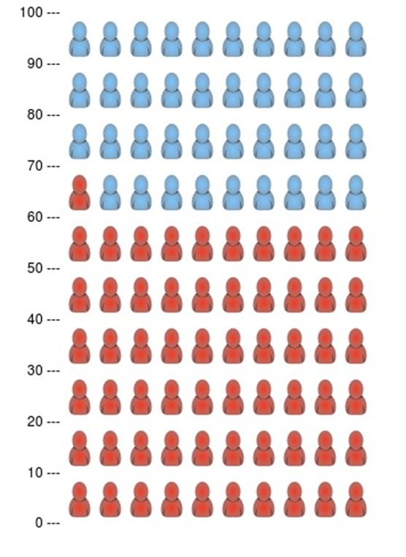
The problem of pertussis in California
11,203 cases in 2014
4683 cases in 2015
4% hospitalized
26-28% ICU
61-69% < 4 months old
all deaths (4) were infants < 5 weeks old
Source: California Department of Public Health Pertussis Report 1/25/16
Proportion of hospitalizations
that were infants <4 months old
Notes:
As I mentioned, newborns and infants are at highest risk of complications and death from pertussis. This slide shows that for every 100 people hospitalized for pertussis, 61% are less than 4 months old. All of the deaths from pertussis in 2014 and 2015 occurred in infants less than 5 weeks old. This tells us that we should be working to protect our youngest citizens, particularly in the first few weeks and months of their lives.
1 death in 2015, 3 in 2014

Slide 9
The problem of pertussis
Immunity induced by pertussis vaccine wanes over time, sometimes in as little as two years after vaccination.
Following a pertussis outbreak in 2012, the U.K. implemented nationwide Tdap vaccination of pregnant women
91% effective in preventing pertussis infections in infants
Cherry JD. Editorial Commentary: Tetanus-Diphtheria-Pertussis Immunization in Pregnant Women and the Prevention of Pertussis in Young Infants, Clinical Infectious Diseases (2015) 60(3):338-340. doi: 10.1093/cid/ciu823
Amirthalingam G, et al. Effectiveness of maternal pertussis vaccination in England: an observational study, The Lancet (2014) 384(9953):1521-8.
Dabrera G, et al. Clin Infect Dis. A case-control study to estimate the effectiveness of maternal pertussis vaccination in protecting newborn infants in England and Wales, 2012-2013. 2015 Feb 1;60(3):333-7
Notes:
We know that immunity to pertussis wanes over time, maybe as little as 2 years after vaccination. In 2012 there was a pertussis outbreak in the UK. The government implemented a nationwide Tdap vaccination program for pregnant women which reduced hospitalizations by 70% for babies under 3 months. The vaccine was 91% effective in this age group.

Slide 10
Mom was vaccinated 1 year ago, should she be vaccinated during the current pregnancy?
Yes
No
Notes:
Answer A

Slide 11
Why vaccinate during pregnancy?
Vaccination is the most important strategy to prevent infection and death in infants (CDC)
Repeat and closely spaced doses are safe
Third trimester vaccination recommended by CDC, ACOG and AAFP, regardless of vaccination history
Antibodies to pertussis are actively transported across the placenta to fetus
de Voer RM, et al. Seroprevalence and placental transportation of maternal antibodies specific for Neisseria meningitidis serogroup C, Haemophilus influenzae type B, diphtheria, tetanus, and pertussis. Clin Infect Dis. 2009 Jul 1;49(1):58-64.
Gall SA, et al. Maternal immunization with tetanus-diphtheria-pertussis vaccine: effect on maternal and neonatal serum antibody levels. Am J Obstet Gynecol 2011;204
Hardy-Fairbanks et al. Immune responses in infants whose mothers received Tdap vaccine during pregnancy. PIDJ. 2013.
Munoz et al. Safety and Immunogenicity of Tdap during pregnancy in mothers and infants: A randomized clinical trial. JAMA. 2014.
Notes:
To summarize, vaccination in pregnancy rather than the postpartum period has many benefits. Pertussis antibodies are transported across the placenta to the fetus and so both the mother and the newborn have pertussis protection at the time of delivery. We know that repeated and closely spaced doses of Tdap are safe. As such, the CDC and several large societies recommend third trimester vaccination regardless of vaccination history. Once a mother is vaccinated, it takes up to 2 weeks for her to mount a protective antibody response. The baby is born without immunity and it may be weeks before antibodies are present in high enough levels in breast milk to confer protection (and this is if the mother chooses to breastfeed). However, if a mother is vaccinated in the 3rd trimester of pregnancy, antibodies are passed through the placenta to the fetus and the baby has pertussis protection from birth. Additionally, the infant will receive protection from breastfeeding starting at birth.
So to return to the previous question, of whether a women in her third trimester of pregnancy should be vaccinated if she was vaccinate 1 year prior, the answer is yes.

Slide 12
Who is responsible for delivering preventive services during pregnancy?
Provider
RN
MA
Case manager
Pharmacist
Notes:
Answer: Trick question! All of the above.

Slide 13
Prenatal Tdap Vaccination Toolkit: A Quality Improvement Primer
www.sfcdcp.org/tdaptoolkit
Notes:
So now that you know why prenatal Tdap vaccination is so important, we’d like to introduce you to a toolkit we’ve produced to help you, in your prenatal care practice improve vaccination rates. Besides being good for patient outcomes and public health, it’s great for increasing team spirit within the practice, encouraging professional development and may get you some needed credits for your specialty recertification.
First, a couple of poll questions.

Slide 14
Where do your patients get Tdap now?
In my office/practice
In another provider’s office/practice
At the pharmacy or public health department
Somewhere else
I don’t know

Slide 15
How often do you provide Tdap vaccination in your practice?
Rarely
Sometimes
Routinely
Notes:
If you answered “in my office,” how often ?

Slide 16
Why QI?
Make changes that lead to better patient outcomes.
Goal: To work smarter not harder
Notes:
So why do we want to think about quality improvement? It is certainly a buzzword these days. It’s a requirement for board recertification. A payor may be asking for it.
But, like I alluded to earlier, we think about quality improvement for a variety of different reasons. Ultimately, it is about improving patient care and outcomes. And by improving our work, I don’t mean greater productivity or more work, I mean better, more efficient and satisfying work. And with the trend towards value-based payment, higher quality may also mean higher revenue for yourself or your organization.
The reason to have a framework for improvement is that what we’re trying to improve in our practices are complex systems – there are a large number of interacting components. A framework helps keep the effort understandable, organized and effective.
There are many QI frameworks with different names but they all boil down to the same thing. I will present one way of thinking about QI but if you find another framework or tool that works better for you or your organization, go with that.

Slide 17
A Multidisciplinary Approach
Team: Provider, Nurse, Clerical, Allied, QI/Analyst
Include patients
Meetings: Regular and brief; minutes and action items
Workplan: tasks, target completion dates and responsible individual
Notes:
Since our practice is a complex system, it is very important to have a variety of representatives of that system thinking about the improvement. Include front line staff included at the beginning of the process. They are the individuals that will ultimately carry out the change. Include patients, they make the work real and have valuable insight.
Meetings are not the focus of the work. They should be brief and action oriented. Use them to make decisions and establish next steps. Kind of like a huddle for those of you who are familiar with that concept from the clinical setting. Keep note of action items, target dates and responsible individuals.
The toolkit has a template you can use to keep track of these elements – can be used as both an agenda and minutes.

Slide 18
Four key questions in QI
What are we trying to accomplish?
How will we know that a change is an improvement?
What changes will we make that will result in an improvement?
How do we make the changes?
Source: The Model for Improvement, The Institute for Healthcare Improvement
Notes:
The Institute for Healthcare Improvement, a great resource with practical tools related to QI. This is called the Model for Improvement
IHI thinks about it with four key questions.
We’ll go more deeply into each one but if you remember two things related to quality improvement from this webinar, this slide would be the first thing to remember.

Slide 19
The Model for Improvement
What are we trying to accomplish?
How will we know that a change is an improvement?
What changes will we make that will result in an improvement?
How do we make the changes?
Notes:
The first step of the improvement process is to clarify and write down what you are trying to accomplish, change or improve. You know what the problem is, in our case, low Tdap vaccination rates. What is your vision for the future? Vaccination within your practice or, Eg Tracking of vaccinations that occur outside of your practice. Make sure the team members are all on the same page with a shared vision.

Slide 20
SMART Goal
Specific: Focused and easy to understand
Measurable: Data
Achievable: Possible to accomplish
Results-focused: not process-focused
Time-bound: 60-90 days
Notes:
A way to capture your vision for success is through a smart goal. Smart goals are specific, measurable, achievable, results-focused (rather than process focused) and time-bound. 90 days is a frequently used time frame. You can certainly go shorter, but letting it go longer can lead to a loss of momentum and interest, and distraction by other needs.
Let’s think of a life example: I want to run a marathon.
To accomplish this…… both physically and mentally, I need to break it down.
First, I am going to be able to run 6 miles from my baseline of 3 miles by April 15, 2016. And then, I can make my next goal.

Slide 21
SMART Goal Example
We will increase Tdap vaccination rates during gestational weeks 27 through 36 by 10% from a baseline of 50% to a goal of 60% by June 15, 2016.
Subgoal: We will implement and use a Tdap vaccination standing order for 25% of patients (from 0%) by April 30, 2016.
Notes:
For the Tdap vaccination example, your goal will depend on the resources you have – time, people – and your starting point.
Your overall goal may require subgoals like my marathon example.

Slide 22
The Model for Improvement
What are we trying to accomplish?
How will we know that a change is an improvement?
What changes will we make that will result in an improvement?
How do we make the changes?
Notes:
So now that we know what success means to us. How will we know if we are getting or there with our changes? How will we know that the changes we make are actually an improvement and not just a different direction.

Slide 23
Measure, measure, measure! (before and after)
Example measures of success:
# patients given vaccine
# patients seen
# visits using vaccine standing orders
# total visits
Notes:
You have to measure your progress. Think about your SMART goal. You’ll want to measure your overall goal as well as the sub goals or steps you identify to get there. Here are two examples of measures of success. There are many more in the toolkit. Some measures look at patient outcomes, others look at practice process.

Slide 24
The Model for Improvement
What are we trying to accomplish?
How will we know that a change is an improvement?
What changes will we make that will (actually) result in an improvement?
How do we make the changes?
Notes:
We’ve identified our problem and our vision for the future. We figured out how we’ll know when we get to the future. Now we’re getting closer to talking about solutions but not just yet.
Before that, we have to understand why the problem exists.
In medicine, this process is called a work-up and a differential diagnosis.
Or a real-life example. If Jack isn’t doing well in school, we don’t just tell Jack to do better, we try to figure out why he might be doing poorly – is he bored? Is his teacher ineffective? Is he not getting enough sleep? Or enough help at home? Maybe his eyesight or vision are bad. In reality, it might be a bit of all of these things.
This sort of thinking is called a root cause analysis. We do it all the time in our day to day lives.

Slide 25
Root Cause Analysis
A systematic approach to understanding the causes of an adverse event and identifying system flaws that can be corrected to prevent the error from happening again.
or
Figuring out all the reasons for why things are the way they are.
Source: The Institute for Healthcare Improvement
Notes:
Simply put, Root Cause Analysis is figuring out all the reasons for why things are the way they are.

Slide 26
Root Cause Analysis*
Causes
* note, solutions are not part of a RCA
https://en.wikipedia.org/wiki/Ishikawa_diagram
Notes:
One way to list the reasons is by using a fishbone diagram. The left side of this tool divides reasons or causes into different categories. You can use these categories or make your own.
A fishbone diagram is a useful, structured, visual way to think about the root causes of your problem. You may not be able to address all of them but the process will give you a deeper understanding of all of the factors. From there you can choose one or two of the root causes on which to focus your improvement efforts. You can also go back to the diagram later to focus future efforts.
Remember, we’re still talking causes, we’re not talking about solutions yet.

Slide 27
Root Cause Analysis
Notes:
Example RCA for low Tdap vaccination rates.
Now that we understand the full complexity of the problem, we can start to think about some of the solutions.

Slide 28
Identify Solutions
Root Cause | Potential Solution
Forget to do it at the right time | Add Tdap administration to the standard workflow for the 28 week clinic visit.
Provider has too much to do during the visit | Standing orders that allow nursing staff to offer and administer vaccine independently
Patients refuse | Patient educational materials or class
Lack of awareness of the problem | Performance feedback for clinical teams
Notes:
Here, I’ve come up with several potential solutions to our problems based on the root causes
There are sample standing orders for you to adapt on the Toolkit website.
There are also links to great educational materials – do not re-create the wheel.
I’ll talk a little more about performance feedback later.
So, we did a good job of coming up with a list of potential solutions. How do we pick the one or two we want to work on?

Slide 29
Pick a solution to test: Priority Grid
HIGH
Standard workflow for 28 week visit
Standing Orders
IMPACT
High Impact
Low Feasibility
High Impact
High Feasibility
Clinician Performance Feedback
Patient Education
Low Impact
Low Feasibility
Low Impact
High Feasibility
LOW
FEASIBILITY
HIGH
Notes:
A tool I really like is a priority grid. The toolkit has a footnote with more resources if you want to go deeper with this.
With the priority grid, you rate the ease of implementing a solution and you rate its potential impact, that is, how effectively it will move you towards your goal or how many patients you will reach.
It is especially useful when there is disagreement amongst team members. I encourage you to use a white board, post-its and markers. Have everyone gather around and move each post it in response to the discussion. You will usually arrive at consensus allowing you to pick the most highly feasible and impactful solutions from your list.

Slide 30
The Model for Improvement
What are we trying to accomplish?
How will we know that a change is an improvement?
What changes will we make that will result in an improvement?
How do we make the changes?
Notes:
Now we finally get to where we wanted to start – changing something!
We identified a problem. We imagined our vision of the future. We figured out how to measure our success. We analyzed the root causes of the problem and we identified the most feasible and impactful solution.
We’re going to talk about the second of the two most important takeaways from this talk. PDSA cycles. A PDSA cycle is way to easily test a solution to a problem.

Slide 31
What does PDSA mean?
Pain, Dolor, Sakit, Agony
Perfect, Disseminate, Stress out, Annoy
Plan, Do, Study, Act
Notes:
Though the common reactions to requests for change, a PDSA is not option A
Neither is it B, even though this is how we usually approach change – Complicated plans created by a few people in a meeting room “rolled out” to a stressed-out and annoyed front-line staff.
PDSA, as many of you probably already know, is C, Plan, Do, Study, Act.

Slide 32
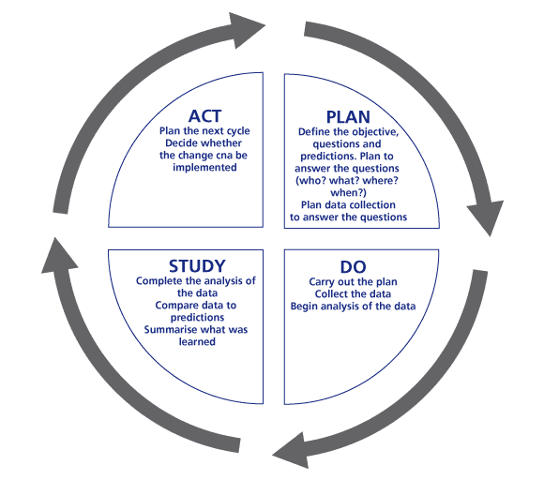
Rapid Cycle Tests of Change (PDSA)
Plan: Who?What?Where?When?
Do: Test it out in real life on a small scale
e.g. 3 patients or one day
Study: Discuss and adjust
Act: Test again the next day
Notes:
One of the hardest things about achieving a large goal (like running a marathon or getting out of the house on time) is the anticipation of the amount of work it will take to get there. As we do in our own lives, break down the large goal (change) into small, quick steps.

Slide 33
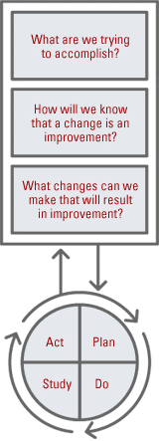
Four key questions in QI
What are we trying to accomplish?
How will we know that a change is an improvement?
What changes will we make that will result in an improvement?
How do we make the changes?
Source: The Model for Improvement, The Institute for Healthcare Improvement
Notes:
So that’s it! The quality improvement process is really just four simple steps.

Slide 34
Using Data to Drive Improvement
Communicate QI activities
Public or semi-public data wall
Team competition
Shared goal to promote office or team spirit
Accountability to staff and patients
Value-based reimbursement
Notes:
The last thing I want to talk about is using data to drive improvement and improve communication in your practice. It is a culture shift that has been happening in healthcare for a while. Kaiser was clearly an early adopter with provider performance feedback. CMS has now taken the lead at the national level with value-based reimbursement.
It is now the norm to measure the quality of our work and compare that to our peers at least on the organizational level. Doing that on the individual level will lead to similar results, better quality and satisfaction for both patients and providers.

Slide 35
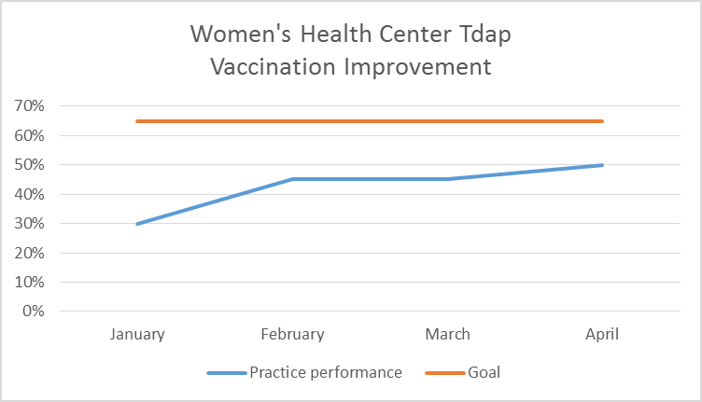
Using Data to Drive Improvement
Notes:
Here are some examples of how to display data.
Both graphs show trends over time.
Top graph – incite a bit of competition between teams. The horizontal line at the top is the overall practice goal.
Bottom graph – keep up enthusiasm, show the practice how it’s efforts are moving it closer to the goal.
You might be thinking that your providers would never go for this. Start with the lower graph. Then add anonymous comparison data. Then consider identifying the teams. It’s a culture change that will take time.

Slide 36
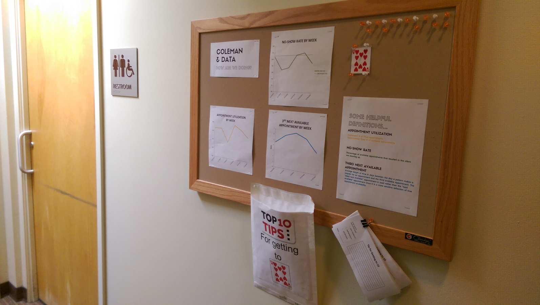
Data Wall
Photo of data wall
Women’s Community Clinic, San Francisco, California
Notes:
Another example of public data sharing for accountability is the San Francisco Community Clinic Consortium http://www.sfccc.org/our-partner-clinics/

Slide 37
Toolkit
www.sfcdcp.org/tdaptoolkit
Notes:
Here is a little tour of the Toolkit.
Remember to tell us about your efforts and your baseline data.

Slide 38
Additional Resources
Institute for Healthcare Improvement
ACOG immunization resources
ACIP Recommendations
California Department of Public Health Pertussis Summary Reports
Storage and Handling
Patient Education
EZIZ

Slide 39
Questions?
sona.aggarwal@sfdph.org

Slide 40
Evaluation

Slide 41
Thank You!

